Slide 1
Defending Journalism and Labor Rights in an Ever-changing Media Landscape
EUROPEAN FEDERATION OF JOURNALISTS
ATHENS | October 2013

Slide 2
EFJ: Just another office in Brussels?
Regional organization of the International Federation of Journalists (IFJ)
Established as an Association International sans But Lucratif under Belgian law
Over 30 countries
Over 40 Unions
Over 300,000 journalists
Rather an ever-expanding network over Europe headquartered in Brussels, created to represent the interests of journalists' unions and associations and their members
ATHENS | October 2013

Slide 3
Our structure
Steering Committee (administrative body elected by General Meeting)
Nine members three-year term
Current composition: Denmark, Russia, Germany, UK, Italy, Greece, Spain, Poland, Switzerland
Secretary-General
Four Expert Groups
Authors’ Rights Expert Group (AREG)
Broadcasting Expert Group (BREG)
Labor Rights Expert Group (LAREG)
Freelancers Expert Group (FREG)
NEW (some say: late) ENTRY: Cross-media, Online and Digitization (CONEG)
Secretariat: Co-Directors, Projects Officers
ATHENS | October 2013

Slide 4
What are our aims and objectives?
By cutting a long list short to highlight the ones related to our session:
to improve and defend the social and working conditions of all journalists, employed and freelancers
to promote co-operation between member unions and associations
to encourage the provision of professional and trade union education and training for journalists
to work closely with other trade unions and with relevant NGOs and social partners in the Media field
[the list of partners is long, comprising numerous European Institutions, The Council of Europe, European Trade Union Confederation, Union Network International, European Broadcasting Union, World Association of Newspapers – the list of acronyms is every newcomer’s nightmare…]
to promote and maintain editorial democracy
ATHENS | October 2013

Slide 5
Alright, but why are we here?
Because the description on your project’s page reflects our suffering and our hope
Journalism has been heavily affected by the described process in terms of:
Labor rights and working relations
Authors’ rights
Quality and Ethics
The production/consumption of news
ATHENS | October 2013

Slide 6
What exactly has changed?
Survey conducted by
Dr. Andreas K. Bittner for EFJ
Tracking the major challenges for European Journalists’ Unions and the way they are trying to face them
ATHENS | October 2013

Slide 7
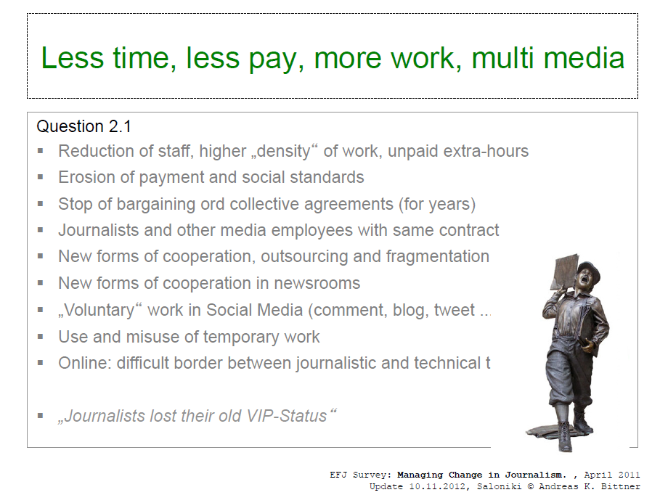
Some key findings…
ATHENS | October 2013

Slide 8
… and some major challenges
ATHENS | October 2013

Slide 9
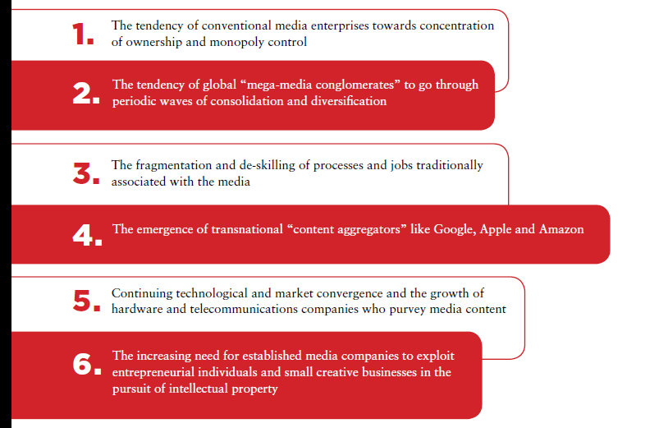
Another thorough case study
Survey conducted by Gary Hermann for EFJ and EURO-MEI
Comparing the Media industries of UK and France and tracking changes that affected the way journalists work
ATHENS | October 2013

Slide 10
Seminars, surveys, projects
Thessaloniki, 2010: Authors’ Rights in the digital age: A fair share for Journalists
Helsinki, 2010: Managing Change in journalism
Thessaloniki, 2012: Equal Rights for Journalists
Vienna 2014: Financial and employment models for journalism
ATHENS | October 2013

Slide 11
Encouraging members’ initiatives…
Initiative of eight partners representing the journalist, media education, VET as well as the consulting sectors, established in six EU Member States (i.e. Belgium, Cyprus, Greece, Germany, Romania, and the Netherlands)
Identify the current skills and training needs of journalists as well as the current situation of journalists VET training in the partners’ countries.
Offer training material, new opportunities and tested training methodologies specifically designed for the needs and demands of journalists.
Foster sustainability and exploitation by producing a complete training programme (including face-to-face and online learning) for journalists.
Increase the employability of journalists by offering new and innovative ways of media training
ATHENS | October 2013

Slide 12
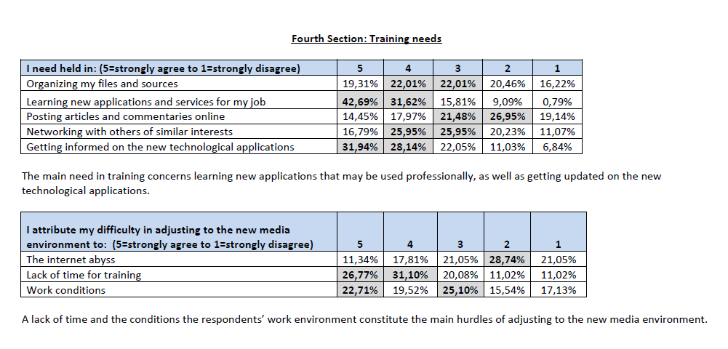
… and taking advantage of their findings
ATHENS | October 2013

Slide 13
A sob story about newspapers’ death?
We are not supposed to protect specific news platforms but working places, working conditions and journalism as a public good.
But when an online journalist confesses: After about 15 years of editing and publishing news online, people in my company are tired. Journalism has never been an easy or quiet job, but working for an online news site is like working for a news agency, even quicker. Many of my colleagues suffered from burnout…
It is clear that virtual work’s management is a key issue for us to meet our aims efficiently.
ATHENS | October 2013

Slide 14
Any chance for proposals?
Adapt to reality
Create new tools to meet new challenges
Change your internal structure, innovate
Support training at unions, working places, everywhere…
Get employers involved
Encourage change, invest in it
ATHENS | October 2013

Slide 15
Contact Us
EFJ President: Mogens Blicher Bjerregård General Secretary: Ricardo Gutierrez
Directors: Renate Schroeder and Marc Gruber
Administrative Officer: Bernard Vanmuysewinkel
Tel. +32 2 235 22 08 Headquarters: European Federation of Journalists Residence Palace Rue de la Loi 155 B-1040 Brussels Belgium Tel: 32-2-235 22 08 Fax: 32-2-235 22 19 E-mail: efj@ifj.org
Presentation by:
Yannis Kotsifos
Director General
JOURNALISTS’ UNION
of Macedonia and Thrace
Daily Newspapers
5, Stratigou Kallari
54622 THESSALONIKI - GREECE
TEL +302310243575, +306937213160
FAX +302310220349 E kotsifos@esiemth.gr
SKYPE yanniskotsifos

